Slide 1
© 2018 Cengage Learning®. May not be scanned, copied or duplicated, or posted to a publicly accessible website, in whole or in part.

Slide 2
Customer Behavior
2
© 2018 Cengage Learning®. May not be scanned, copied or duplicated, or posted to a publicly accessible website, in whole or in part.

Slide 3
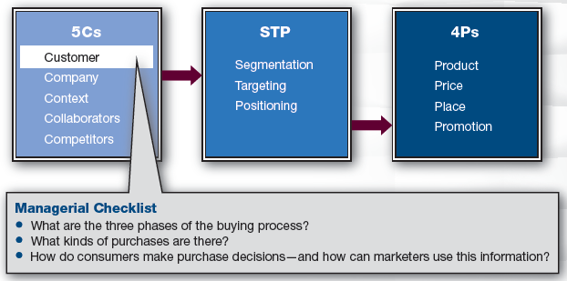
Marketing Framework

Slide 4
Discussion Question #1
Describe the process you used when you decided which college to attend.

Slide 5
The Science of Consumer Behavior
There are known, reliable patterns that comprise consumer behavior, including:
  The phases consumers go through when making a purchase
  The different kinds of purchases that consumers make
  How consumers sense and perceive, become motivated, form attitudes, and make decisions
  The cultural differences that influence consumers

Slide 6
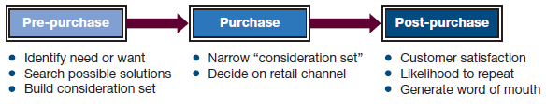
The Purchase Process

Slide 7
Pre-Purchase Phase
Customers recognize a need/desire
  Some are heavily marketer influenced; some are not
    e.g., Having trendy clothes vs. needing to eat
Customers search and evaluate products that address their need
    e.g., Conduct online search, ask friends, etc.
Customers create a consideration set
  All brands considered as candidates for purchase

Slide 8
Discussion Questions #2
What need/desire drove you to consider “purchasing” college?
How did you search for information?
Which colleges were in your consideration set?
What criteria did you utilize to form this set?

Slide 9
Purchase Phase
Customers narrow the consideration set
  Customer may delay the purchase
  Customer may decide not to purchase
Customers decide on retail channel

Slide 10
Post-Purchase Phase
Customers assess the purchase and the purchase process
Customers determine satisfaction
  Did the customer get what he expected?
Customers’ level of satisfaction leads to
  Repeat purchases
  Negative or positive word of mouth
  Product returns, etc.

Slide 11
Discussion Questions #3
Are you satisfied with your college decision? Why or why not?
Could your level of satisfaction affect the college? If so, how?

Slide 12
Who Utilizes the Purchase Process?
Business-to-Consumer (B2C) and Business-to-Business (B2B) both utilize the buying process
  The amount of time spent on a stage depends upon what is being bought
A business customer is an agent buying something on behalf of an organization
    e.g., Administrative assistants, operations department, etc.

Slide 13
Three Types of Consumer Purchases
(slide 1 of 2)
Convenience purchases
  Low involvement; standard, frequently consumed goods or impulse purchase
  Consumers don’t spend much time thinking or planning the purchase
Shopping purchases
  Medium involvement; not as frequently purchased
  Consumers spend time and effort prior to purchase

Slide 14
Three Types of Consumer Purchases
(slide 2 of 2)
Specialty purchases
  High involvement; occasional purchases, often more expensive, require more thought
  Customers put much effort into the purchase

Slide 15
Types of Business Purchases
Straight rebuy
  Low involvement; purchase what was purchased last time with little or no thought
Modified rebuy
  Medium involvement; something about the purchase is altered requiring some thought
New buy
  High involvement; purchase something that hasn’t been purchased before requiring much thought and planning

Slide 16
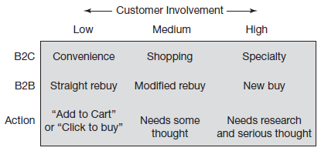
Types of Purchases

Slide 17
Low-Involvement Purchases
Low-involvement purchases
  Have more price sensitivity
  Use price discounts
  Generally don’t generate word of mouth
  Are usually distributed intensively
  Marketers should focus on how to capture consumers’ attention

Slide 18
High-Involvement Purchases
High-involvement purchases
  Have less price sensitivity
  Use brand communities and events
  May generate word of mouth
  Are usually distributed selectively
  Marketers should focus on providing consumers with information

Slide 19
Anatomy of a Grocery Store
Layout of a grocery store encourages purchases
  Group similar products
  Group complementary products
  Place common purchases far from the entrance
  Group products to form consideration sets
  Place high-profit and impulse-purchase items at end of aisles and checkout lanes

Slide 20
Sensation and Perception
(slide 1 of 5)
Utilize senses to convey information
Consumers have selective attention; they block out what is not relevant
Visual: colors can convey
  Product characteristics (white for freshness for toothpaste)
  Brand identity (Tiffany’s aqua blue)
  Meaning (affected by culture)

Slide 21
Sensation and Perception
(slide 2 of 5)
Hearing can
  Increase spending
    e.g., Quick tempo music = increased spending
  Convey a brand
    e.g., Harley-Davidson’s distinctive sound
Smell can
  Get attention
    e.g., Smelling the Cinnabon store
  Allow product sampling
    e.g., Perfume in magazines

Slide 22
Sensation and Perception
(slide 3 of 5)
Taste can
  Distinguish one brand from another
    e.g., Coke vs. Pepsi
Touch can
  Convey brand imagery
    e.g., Well-designed products compared to value designed products
    e.g., Ergonomics, clean lines, simplicity, beauty, and sensual experiences

Slide 23

Sensation and Perception
(slide 4 of 5)
Subliminal advertising
  An ad that is shown so quickly that is doesn’t meet the threshold of liminal recognition
  Has been debunked by research

Slide 24
Sensation and Perception
(slide 5 of 5)
Mere exposure
  Repeated exposure to an ad brings familiarity and a positive feeling
Perceptual fluency
  Customers may pay the most attention to the content of a message
    However, the colors, font, etc. make a brand impression as well

Slide 25
Learning, Memory, and Emotions
Sensory and perceptual impressions can become brand associations
Learning is the process by which associations get past the sensory and perception stages into short-term memory and then, with repetition and elaboration, into long-term memory
  Classical and operant conditioning

Slide 26
Classical Conditioning
(slide 1 of 2)
Pavlov’s dogs
  Stage 1: a dog drools at sight of food
  Stage 2: a dog doesn’t respond to a bell
  Stage 3: ringing a bell while placing food in front of the dog elicits drool
  Stage 4 (occurs over time): a bell rung in front of the dog elicits drool
A similar process can be used in advertising and jingles

Slide 27
Classical Conditioning
(slide 2 of 2)
Companies may have negative brand associations in customers’ memories
Some companies change names to help create new associations
    e.g., Philip Morris is now Altria
    e.g., ValuJet is now AirTran

Slide 28
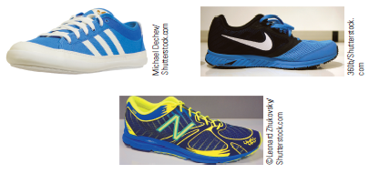
Discussion Question #4
Use classical conditioning theory to explain this advertisement.

Slide 29
Operant Conditioning
Skinner used pigeons to show that learning occurs by positively reinforcing behavior
  Fixed ratio reward: reward is given every time or every 4th time, etc.
  Variable ratio reward: reward timing varies unpredictably
  Subject will engage in the behavior more often if rewarded on the variable schedule

Slide 30
Discussion Questions #5
Discuss how a deli could utilize operant conditioning to design a loyalty program under
  fixed ratio reward, and
  variable ratio reward
Which reward ratio do you think would be more effective and why?

Slide 31
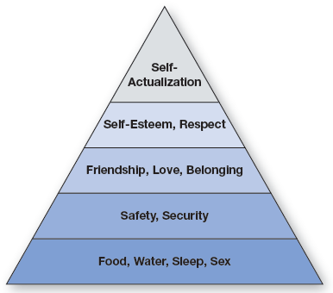
Motivation: Hierarchy of Needs

Slide 32
Maslow’s Hierarchy of Needs
(slide 1 of 2)
Maslow suggests that people must have their basic needs met before moving on to more abstract needs
Marketers may identify their product with one of Maslow’s needs
    e.g., Volvo and safety needs
  Many brands are associated with a sense of belonging, social acceptance, and respect

Slide 33
Maslow’s Hierarchy of Needs
(slide 2 of 2)
Marketers may identify products with aspiration groups
Marketers may offer an extended brand line for customers at different levels in Maslow’s hierarchy
    e.g., Mercedes has a lower-end C model, then upward to E, S, and finally CL models
Marketers use hierarchy for positioning

Slide 34
Distinguishing Motivations
Utilitarian vs. hedonic
    e.g., Suit for interviews vs. Armani suit
Conformity vs. individuality
  May vary over lifetime or in different situations
Risk seeking vs. risk averse
  Risk tolerance may vary with product knowledge

Slide 35
Attitudes and Decision Making
Attitudes and decision making influence whether consumers
  Will buy a brand
  Repeatedly purchase it
  Become loyal
  Recommend it to others, etc.

Slide 36
What Are Attitudes?
Attitudes are a mix of beliefs and importance weights
  Beliefs
    e.g., I think Sprite has caffeine
  Importance
    e.g., I think having caffeine is important
  Customer may differ on both importance and beliefs

Slide 37
Decision Making
(slide 1 of 3)
Decision making:
  With a few choices, consumers easily compare brands to make decision
  With many choices, consumers use two stages:
    Stage 1: Determine consideration set
    Stage 2: Compare brands to make a purchase decision

Slide 38
Decision Making
(slide 2 of 3)
Stage 1
  Non-compensatory method: if a brand doesn’t have important attributes, it is cut
    Lexicographic method: compare all brands on most important attribute; cut brands that don’t have it; move on to next important attribute and compare and cut, etc.

Slide 39
Decision Making
(slide 3 of 3)
Stage 2: Compare brands in detail
  Compensatory model (cost/benefits)
    One excellent attribute can compensate for a poor attribute
  Some websites aid this process by allowing users to view a side-by-side comparison of attributes

Slide 40
Cultural Differences
Socio-cultural differences influence consumers and produce shopping patterns
  Social class
    e.g., Old-monied people seek exclusivity; nouveaus indulge in conspicuous consumption
  Age
    e.g., Young people buy furniture; as they get older they buy diapers and minivans; then college and finally healthcare

Slide 41
Discussion Question #6
How can a marketer capitalize on the Baby Boomer segment?

Slide 42
Managerial Recap
(slide 1 of 2)
Three major phases of consumption
  Pre-purchase, purchase, post-purchase
Three major classes of purchases
  B2C: convenience, shopping, specialty
  B2B: straight rebuy, modified rebuy, new buy
  Involvement determines class

Slide 43
Managerial Recap
(slide 2 of 2)
How do consumers think?
  Sensing and perceiving information that is learned and stored in memory
  Motivations help marketers understand what consumers are seeking to satisfy
  Attitudes and decision making are subject to influence by good information and biases
  Social norms define consumers

